Slide 1
Experiencing Agile as a Developer
How Agile Transforms Development from Chaos to Clarity

Slide 2
Introduction
Background:
Computer Science teacher and mentor
Web-apps back-end developer (.NET, SQL)
Mobile games developer (Unity, C#) in key developer and lead roles
Generalist programmer (Unreal, C++)
Notes:
Hi, I’m Paulina, a programmer with experience across a range of projects using different process approaches.
I’ve worked on:
An outsourced project with a complex architecture and cross-team collaboration. Predictability was crucial for the customer, so we adhered to traditional Agile practices.
A large game project that launched extremely successfully and then aimed to scale fast, also following classic Agile.
Small, time-boxed mobile projects that needed quick prototyping and tight deadlines, with the goal of delivering on time, often without long-term perspectives.
A chaotic startup where I tried to introduce Agile processes in a disorganized environment, and another project that started with Agile but abandoned it later.
Today, I’d like to share how these different management approaches—especially Agile—have impacted teams, project success, and development outcomes.

Slide 3
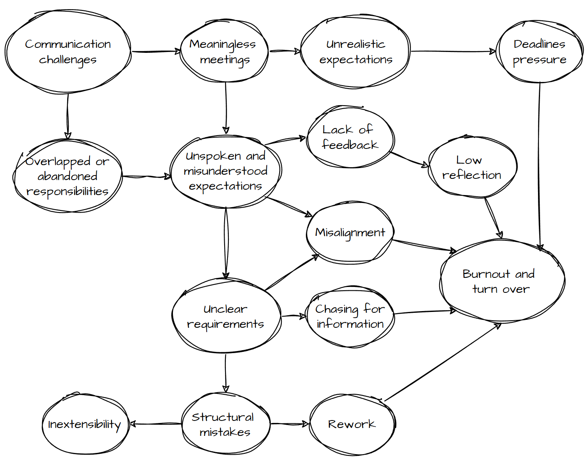
Common challenges
Notes:
First let’s look at common challenges teams face without structured processes.
It often starts with unclear responsibilities—when roles aren’t well-defined, expectations become unspoken or misunderstood.
This leads to unclear requirements, which make developers inefficient.
Developers either implement features that will likely need rework or spend time chasing people for missing information. Inefficiency also extends to time spent in meetings that lack clear purpose, which can drain energy.
Unclear requirements also lead to structural mistakes in the codebase, making it hard to extend the project later.
Add misalignment between teams, lack of feedback, and ultimately, you end up with burnout and high turnover.

Slide 4
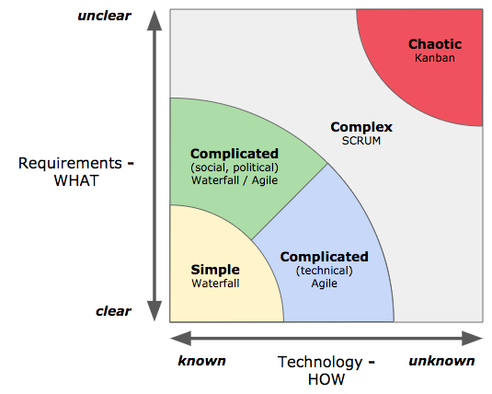
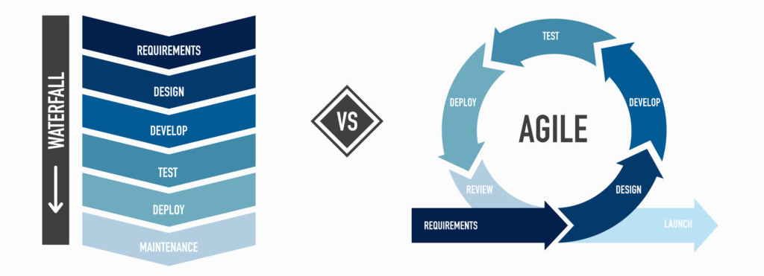
Management Approaches
Notes:
Let’s briefly look at approaches that might help us structure the processes.
The traditional for games approach is Waterfall, as before Steam games where limited by disks distribution, so when we wanted to make a game we had to think hard what we want to do, then focus on design and prototyping, then for development fase team could expand tremendously, then when everything was ready, we were testing and finally deploy. In this environment we didn’t have lots of opportunities to react to changes
Agile embraces that change, allowing you to adjust as new information emerges. For example, as new game mechanics are tested and reviewed by QA or the community, Agile lets you modify your approach without derailing the entire project.
The Stacey Matrix helps us understand how different approaches like Waterfall and Agile fit different types of projects based on how clear the requirements and technical solutions are.
Most of early R&D stages in game development appear in Chaotic section because both the goals and the solutions are unclear, so in order to approach it we want to decrease uncertainty, that brings us to Complex section, where iteration approach can help us to eat elephant by small pieces, which is Simple enough to approach it with directly and receive a feedback in a short period of time.

Slide 5
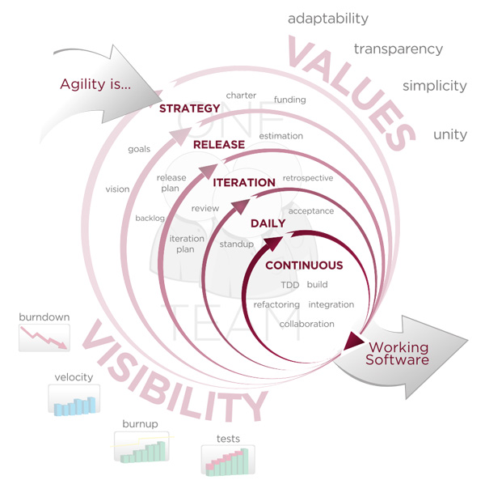
Essential Agile Practices
Definition of Done
Backlog Grooming
Sprint Planning
Daily Stand-ups
Continuous Integration
Retrospectives & Sprint Review
Notes:
Agile is focused to have a working product at the end of every iteration. It also provides iteration framework on all levels of production, from high-level strategy to changes submit, which suggests adjusting to feedback and requirements changes
Let's explore a few key processes and routines that directly address common developer pain points:
Backlog Grooming: Throughout the project, the product backlog (a prioritized list of tasks) is reviewed and refined. For developers, this ensures that the most important tasks are always at the top of the list and that each task is properly detailed before it’s selected for a sprint. This eliminates the stress of receiving vague tasks at the last minute and enables better focus on what really matters.
Definition of Done: Agile teams often establish a "definition of done" to clarify when a feature is complete. This may include code reviews, passing tests, and approval from relevant stakeholders. Having a clear standard reduces the uncertainty of what’s expected from a developer when finishing a task, so there’s no second-guessing whether a feature is truly finished.
Sprint Planning: During sprint planning, the team sets clear goals and expectations, which ensures that everyone knows exactly what’s required. This helps developers avoid the frustration of unclear or constantly changing requirements.
Daily Stand-ups: Teams meet briefly each day to discuss progress and any challenges they face. For developers, this keeps communication flowing and helps identify blockers early, ensuring you don’t waste time on rework or misaligned tasks.
Continuous Integration: Agile promotes frequent integration of code changes into a shared repository, often paired with automated testing. For developers, this ensures that bugs and issues are caught early, preventing the dreaded situation where months of development need to be debugged all at once. This is especially critical in game development, where features and mechanics interact in complex ways.
Retrospectives: After each sprint, the team reflects on what worked well and what can be improved. This continuous feedback loop helps both developers and management refine how they work together, making improvements each sprint.
Agile, with these practices, provides a structured yet flexible approach to managing complexity, offering a way to adapt to changing conditions and unclear requirements. It’s especially valuable in development environments where uncertainty is high.

Slide 6
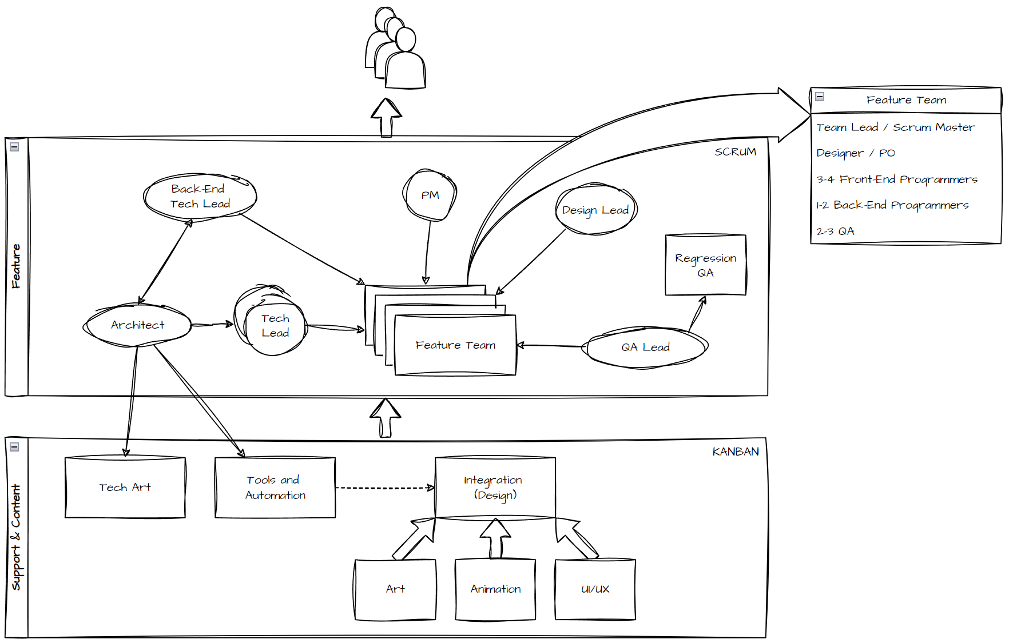
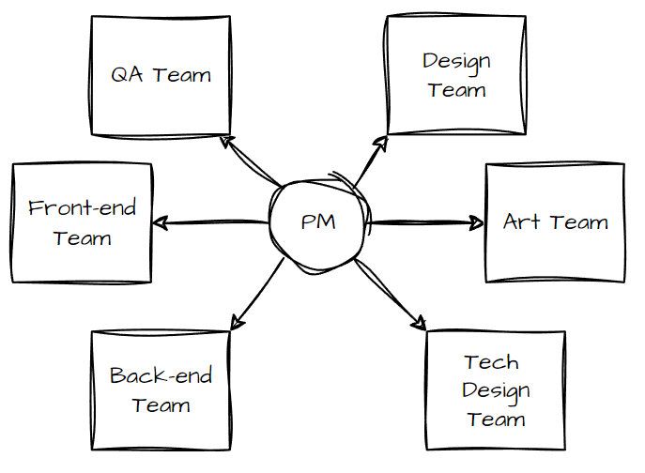
Case #1: Agile as growing rails
Notes:
I joined this project right before launch which appeared more successful than expected, so they decided they need to grow and fast. They had a team of 40 people organized into discipline teams around a Project Manager.
To grow they reorganized teams into Cross-Functional Feature and Support & Content Teams, Feature teams were responsible for delivery and gluing everything together, when Support and Content teams were providing all needed content.
Around feature teams were organized management, like Architect and tech leads were overseeing technical implementation, QA lead - QA processes, Design lead - PO activity and requirement definition, PM - overall management.
I ended up in one of feature teams among other 2 Unity devs, 1 back-end dev, 2 QA, 1 game designer that played PO role and Team lead aka scrum master.
In 3 month they added 2 more feature teams and expanded support teams, so project grew up to 120 people.

Slide 7
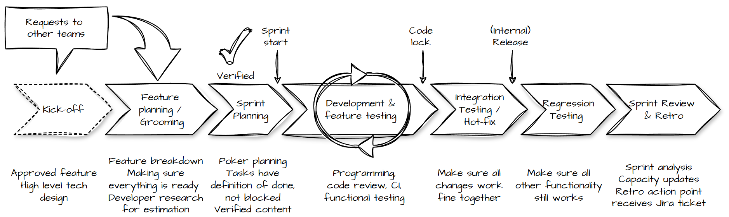
Case #1: Agile for cross-team work
Notes:
As a feature team we were a last point before deployment where we put design, art, sound, animations and tech art. Agile practices allowed us to make sure we have everything we need from other teams before we start the sprint, as they did it in previous sprint.
Another team that we had to work sometimes was a team outside the project that worked on centralized configurations aggregator. Sometimes we had to have there new entities for our feature. Agile requirements gathering practices allowed us to figure out this need early, specify the entities structure and get this API done before we start the sprint for implementing the feature.

Slide 8
Case #1: Agile for tech improvements
Project had to expand and needed tech improvements
Capacity for tech debt
Separate team for Automation, Build Engineering and Tools
Structured and strategic technical oversight
Cross-team code review and knowledge sharing
Tech syncs for best practices and architectural direction, pitching ideas
Significant architectural shifts
Extensible code base
Fast changing codebase
Complicated branching
Notes:
This launch success also required tech improvements to make sure the project can expand. The scrum structure allowed to book capacity for tech debt in every sprint, tech team was able to focus on automation tools. Reorganizing managing responsibilities and adding Architect role allowed technical oversight become more structured and strategic. To accomplish it we had cross-team code review, automation tools, tech syncs where we got architectural directions, were sharing best practices and step up with ideas.
There were challenges as well: In such a big project and giant code base everything changed super fast, so even familiar part of code could get changed tremendously by the moment you get another task
We had complicated branching strategy with rebases that required attention
But as result we made significant architectural changes in as small period as 6 months among implementing new features: MVCS -> Controllers tree
Monolith -> multiservices

Slide 9
Case #2: Agile to overcome chaos
Chaos period:
Small team to rework code base of another game
Straightforward communication
Momentarily reaction to any product request
Successful prototype
Project accelerating and growth was challenging
Agile introducing:
Project restructure for collaborative work
Build schedule and searching for iteration rhythm
Specifying expected result
CI/CD and branching strategy
Early testing
Authoritative code reviews
Synchronized with other departments
No strategy iterations ->
Unrealistic expectations from management
Notes:
It was a brand new project and tiny-tiny small team.
We had to analyze acquired code base, optimize it, leave only game mechanic and fully change narrative.
In a small team it was easy to communicate any needs and react to management requests.
We were able to make the prototype in 2 months and meet all the expectations, so management decided we need to grow.
Soon we’ve found out project had highly coupled structure that was making collaborative work complicated.
We reorganized fully the project structure and started to implement first levels, but with team growing it became hard to save transparency, management oversight became nervous and destructive, so we decided we need processes.
We started from builds schedule, and specifying what we want to see in those builds, we set up fully automated CI/CD and branching strategy, code reviews took authoritative character as team wasn’t very familiar with code review process.
Management wanted from us fast iterations and builds every week, so we had 1 week sprints which didn’t give us lots of time for planning, but mostly requirements were straightforward.
We were able to bring this rhythm to other teams, structure QA approaches, centralize decision making and give developers peace of work without interruptions.
We started to face out with issues when we had to integrate new features from original game - the code difference was so huge that it almost didn’t make sense to try to merge it, so we had to develop them from scratch, which didn’t correspond to management vision.
I don’t know if it was the reason, but soon the project was cut off, team got laid off and soon the whole company got shut down.

Slide 10
Case #3: Mimicking Agile
Some Agile routines but in ineffective form
Relied on personal connections and passion
Chaotic, impulsive reactions to changes
Meetings that lack purpose drain energy
Works well for small projects
Capable of shipping a product, but with limitations
Notes:
This case combines insights from multiple projects where some Agile routines were in place but lacked effective structure.
In these environments, teams often relied heavily on personal connections and individual passion, which aren’t always reliable or aligned with company goals.
Another common challenge was the chaotic and impulsive response to changes, with decisions often made on the fly.
This setup can work for small projects or teams of around five-ten people, where communication is naturally straightforward.
However, even in larger teams, not having a full Agile structure didn’t mean products couldn’t be delivered—though it’s hard to know if more structure would have led to greater success.

Slide 11
Conclusion
Agile isn’t a magic solution.
It requires trust and buy-in from the whole team to be effective.
Agile is:
Predictability through sprints
Managing growth with Agile
Planning for tech improvements
Stability and growth for developers
Purposeful meetings and communication standards
Reduced developer stress
Notes:
Agile brings predictability, clarity, and a balance of feature development with technical improvements. It also offers opportunities for growth, learning, and purposeful meetings that, when used responsibly, fill communication gaps and allow team members to feel their contributions make an impact. All together reduces stress for developers. This helps Agile foster collaboration and provides an adaptable framework for dynamic projects and fast-paced environments. However, Agile works best when there’s trust and commitment from the entire team.

